Slide 1
Coupled Problems
Strong Coupling
Weak Coupling
Implicit
Explicit

Slide 2
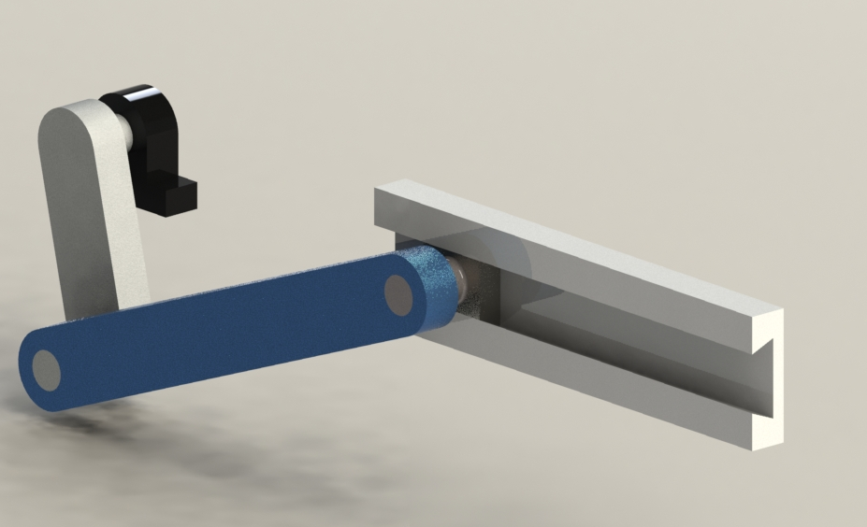
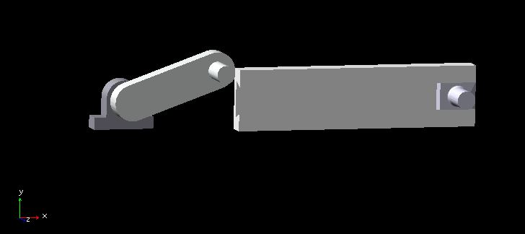
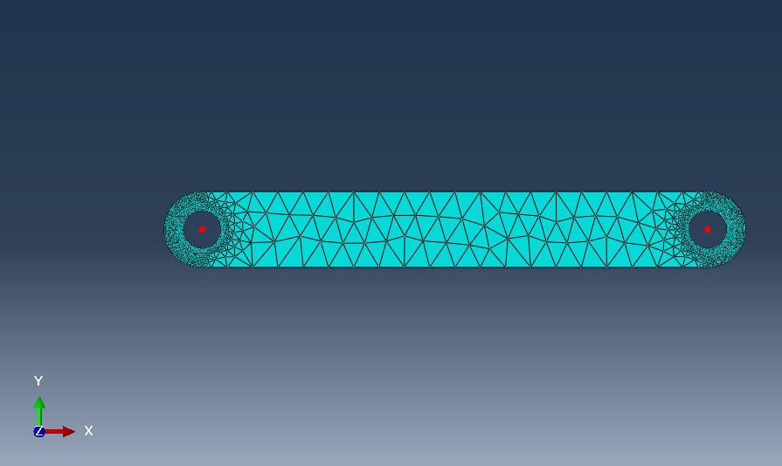
Slider crank CAD
Separate the flexible and rigid bodies
Rigid Body is replaced by Forces
RBD code
FEA code
RBD code
FEA code

